Slide 1
Embedded systems
A system which is a combination of
special purpose hardware and
embedded OS
for executing a
specific set of applications.

Slide 2
Example real-time and embedded systems
Domain | Application
Avionics | Navigation; displays
Multimedia | Games; simulators
Medicine | Robot surgery; remote surgery; medical imaging
Industrial systems | Robot assembly lines; automated inspection
Civilian | Elevator control Automotive system; Global positioning system (GPS)

Slide 3
Definition
An embedded system is a computer system with a dedicated function within a larger mechanical or electrical system, often with real-time computing constraints.
It is embedded as part of a complete device often including hardware and mechanical parts.
Embedded systems control many devices in common use today.
Ninety-eight percent of all microprocessors are manufactured as components of embedded systems.
An embedded system is designed to run on its own without human intervention, and may be required to respond to events in real time.

Slide 4
Features
An embedded system
is a dedicated computer system designed for one or two specific functions.
is embedded as a part of a complete device system that includes hardware, such as electrical and mechanical components.
is unlike the general-purpose computer, which is engineered to manage a wide range of processing tasks.
Because an embedded system is engineered to perform certain tasks only, design engineers may optimize size, cost, power consumption, reliability and performance.
Embedded systems are typically produced on broad scales and. share functionalities across a variety of environments and applications

Slide 5
Real time Characteristics
RTS have to respond to events in a certain pre-determined amount of time.
The time constraints have to be considered during planning, design, implementation and testing phases.
Internal failures due to software and hardware fault have be handled satisfactorily.
You cannot simply pop-up a dialog error box that says “send report” or “don’t send report”.
Also external failures due to outside sources need to be handled.

Slide 6
Realtime Characteristics (contd.)
Typical interaction in an RTS is asynchronous.
Thus an RTS should have features to handle asynchronous events such as
interrupt handlers and
dispatcher and
associated resources.
Potential for race condition: when state of resources are timing dependent race condition may occur.
Periodic tasks are common.

Slide 7
Embedded System
Is a special purpose system designed to perform a few dedicated functions.
Small foot prints (in memory)
Highly optimized code
Cell phones, mp3 players are examples.
The components in an mp3 player are highly optimized for storage operations. (For example, no need to have a floating point operation on an mp3 player!)

Slide 8
Real-time system concepts
A system is a mapping of a set of input into a set of outputs.
A digital camera is an example of a realtime system: set of input including sensors and imaging devices producing control signals and display information.
Realtime system can be viewed as a sequence of job to be scheduled.
Time between presentation of a set of inputs to a system and the realization of the required behavior, including availability of all associated outputs, is called the response time of the system.

Slide 9

Real-time system concepts (contd.)
Real-time system is the one in which logical correctness is based on both the correctness of the output as well as their timeliness.
A soft real-time system is one in which performance is degraded by failure to meet response-time constraints.
A hard real-time system is one in which failure to meet a single deadline may lead to complete and catastrophic failure.
More examples:
Automatic teller: soft
Robot vacuum cleaner: firm
Missile delivery system: hard

Slide 10
Characteristics of embedded systems
Single functioned
Tightly constrained
Reactive and real time

Slide 11
Design metrics
Non-recurring engineering cost – one time monitory cost of designing
Unit cost – cost/unit (excluding NRE)
Size
Performance – execution time
Power
Flexibility
Ability to change the functionality w/o incurring heavy NRE. S/W is typically considered as very flexible
Type of prototype – used to verify the system’s usefulness and correctness and to rectify the systems functionality
Time to market
Maintainability
Correctness – can be checked at every stage of the design process
Safety

Slide 12
RTOS Kernel objects
Tasks
Tasks scheduler
Interrupt service routines (ISR)
Semaphores – used for both resource and task synchronization
Mutexes – mutual exclusion – is the general mechanism used for both resource synchronization as well as task synchronization
Mailboxes
Message queues – a data structure used in an OS to pass data between two or more threads
Pipes – task-to-task or ISR-to-task data transfer can take place using pipes
Event registers – a task can have an event register in which the bits correspond to diff events
Signals
Timers – used for measuring elapsed time

Slide 13
Task and task scheduler

Slide 14
Real-Time System
Real-time systems have been defined as: “those systems in which the correctness of the system depends not only on the logical result of the computation, but also on the time at which the results are produced“
Correct function at correct time
Usually embedded
Deadlines
Hard real-time systems
Soft real-time systems

Slide 15
Real-Time System continue
Soft RTS: meet timing constraints most of the time, it is not necessary that every time constraint be met. Some deadline miss is tolerated.
Hard RTS: meet all time constraints exactly, Every resource management system must work in the correct order to meet time constraints. No deadline miss is allowed.

Slide 16
Tasks Categories
Invocation
Periodic (time-triggered)
Aperiodic (event-triggered)
Creation
Static
Dynamic
Multi-Tasking System
Preemptive: higher-priority process taking control of the processor from a lower-priority
Non-Preemptive : Each task can control the CPU for as long as it needs it.

Slide 17
What is Important in a Scheduling Algorithm?
Minimize Response Time
Elapsed time to do an operation (job)
Response time is what the user sees
Maximize Throughput
Jobs per second
Throughput related to response time, but not identical
Minimizing response time will lead to more context switching than if you maximized only throughput
Minimize overhead (context switch time) as well as efficient use of resources (CPU, disk, memory, etc.)
Fairness
Share CPU among users in some equitable way
Not just minimizing average response time

Slide 18
Why we need scheduling ?!
Each computation (task) we want to execute needs resources like
processor,
memory segments,
communication,
I/O devices etc.
The computation must be executed in particular order (relative to each other and/or relative to time)
The possible ordering is either completely or statistically a priori known (described)
Scheduling: assignment of processor to computations;
Allocation: assignment of other resources to computations;

Slide 19
First Come First Serve (FCFS)
Process that requests the CPU FIRST is allocated the CPU FIRST.
Also called FIFO
Implementation
FIFO queues
A new process enters at the tail of the queue
An unblocked process re-enters at the tail of the queue
The schedule selects from the head of the queue.
Typical performance metric: Average Waiting Time.
Sequence of execution – 4-3-2-1
Task 1 Task 2 Task 3 Task 4
Scheduler

Slide 20
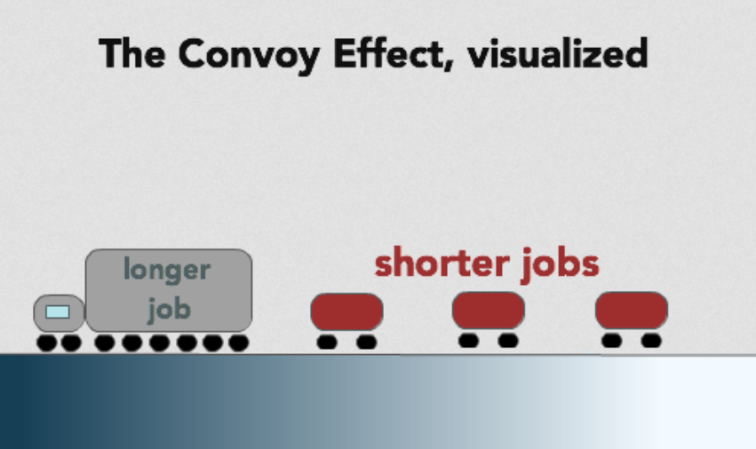
Problems with FCFS
Non-preemptive
Not optimal AWT
Cannot utilize resources in parallel:
Assume 1 process CPU bounded and many I/O bounded processes
Result: Convoy effect, low CPU and I/O Device utilization
Why?

Slide 21
Why Convoy Effects?
Consider n-1 jobs in system that are I/O bound and 1 job that is CPU bound.
I/O bound jobs pass quickly through the ready queue and suspend themselves waiting for I/O.
CPU bound job arrives at head of queue and executes until complete.
I/O bound jobs re-join ready queue and wait for CPU bound job to complete.
I/O devices idle until CPU bound job completes.
When CPU bound job completes, other processes rush to wait on I/O again. CPU becomes idle.

Slide 22
Interactive Scheduling Algorithms
Usually preemptive
Time is sliced into quantum (time intervals)
Scheduling decision is also made at the beginning of each quantum
Performance Criteria
Average response time (AWT)
Fairness (or proportional resource allocation)
Representative algorithms:
Priority-based
Round-robin
…

Slide 23
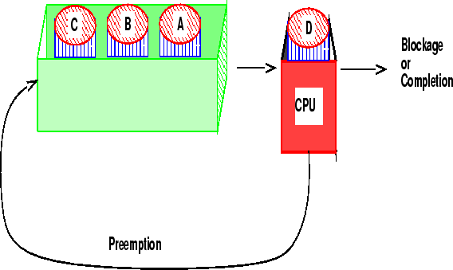
Round-robin
One of the oldest, simplest, most commonly used scheduling algorithm
Select process/thread from ready queue in a round-robin fashion (take turns)
Problems:
Does not consider priority
Context switch overhead

Slide 24
Round-robin: Example
Process | Duration | Order | Arrival Time
P1 | 3 | 1 | 0
P2 | 4 | 2 | 0
P3 | 3 | 3 | 0
Suppose time quantum is: 1 unit, P1, P2 & P3 never block
P1
P2
P3
P1
P2
P3
P1
P2
P3
P2
0
10
P1 waiting time: 4 (2 [p2,p3]+2[p2,p3])
P2 waiting time: 6 (1 [p1] + 2 [p3,p1] + 2 [p3,p1] + 1 [p3])
P3 waiting time: 6 (2 [p1, p2] + 2 [p1,p2] + 2 [p1,p2] )
The average waiting time (AWT): (4+6+6)/3 = 5.33

Slide 25
Round-Robin with Priority
Slightly modified by assigning priority levels to some or all the tasks.
The highest priority tasks can interrupt the CPU so that it can be executed.
The scheduling algorithm can meet the desired response time for a higher priority task.

Slide 26
Shortest Job First (SJF)
Schedule the job with the shortest computation time first
Scheduling in Batch Systems
Two types:
Non-preemptive multi-tasking
Preemptive multitasking
Optimal if all jobs are available simultaneously: Gives the best possible AWT (average waiting time)

Slide 27
Non-preemptive SJF: Example
Process | Duration | Order | Arrival Time
P1 | 6 | 1 | 0
P2 | 8 | 2 | 0
P3 | 7 | 3 | 0
P4 | 3 | 4 | 0
P4 (3)
P1 (6)
P3 (7)
P2 (8)
0
3
9
16
24
P4 waiting time: 0
P1 waiting time: 3
P3 waiting time: 9
P2 waiting time: 16
The total time is: 24
The average waiting time (AWT): (0+3+9+16)/4 = 7

Slide 28
Comparing to FCFS
Process | Duration | Order | Arrival Time
P1 | 6 | 1 | 0
P2 | 8 | 2 | 0
P3 | 7 | 3 | 0
P4 | 3 | 4 | 0
P1 (6)
P2 (8)
P3 (7)
P4 (3)
0
6
14
21
24
The total time is the same.
The average waiting time (AWT): (0+6+14+21)/4 = 10.25
(comparing to 7)
P1 waiting time: 0
P2 waiting time: 6
P3 waiting time: 14
P4 waiting time: 21

Slide 29
Preemptive SJF
Shortest job runs first.
A job that arrives and is shorter than the running job will preempt it
A Problem with Preemptive SJF
Starvation
A job may keep getting preempted by shorter ones
Example
Process A with elapse time of 1 hour arrives at time 0
But every 1 minute, a short process with elapse time of 2 minutes arrives
Result of SJF: A never gets to run

Slide 30
ISR – interrupt service routine
Interrupt latency: max time for which interrupts are disabled + time to start the execution of the first instruction in the ISR is called interrupt latency.
Interrupt response time: Time between receipt of interrupt signal and starting the code that handles the interrupt is called IRT
Interrupt recovery time: time required for CPU to return to the interrupted code/higher priority task is called interrupt recovery time.
Interrupt Service Routine Execution
Task running
CPU Context Saving
CPU Context Saving
Task running
Time
Interrupt request
Interrupt Recovery
Interrupt latency
Interrupt Response Time

Slide 31
Non preemptive
The tasks cooperate each other to get their share of the CPU time
Each task has to release the CPU and give control to another task on its own
Each task is given a priority.
Low priority task running
Interrupt Service Routine
Low priority task running
High priority task running
Time
ISR makes high priority task ready to Run
Low priority task release the CPU

Slide 32
Preemptive
Highest priority task is always given the CPU time.
If a LP task is presently running and a HP task is in Ready-to-run state, the running task is “preempted” and the HP task is executed
Low priority task running
Interrupt Service Routine
High priority task running
Low priority task running
Time
ISR makes high priority task ready to Run
high priority task release the CPU

Slide 33
Semaphores: Kernel object that is used for task and resource synchronization
Semaphore management
Function calls
Create a semaphore 2. Delete a semaphore 3. Acquire a semaphore
4. Release a semaphore 5. Query a semaphore
Display
ADC
Task to write the Data
Task to read the Data
DAC
Task 1
Task 2
Resource synchronization
1. Task 1 acquires semaphore uses display
2. Task 1 releases semaphores
3. Task 2 acquires semaphores
Task 2 uses display
4. Releases semaphore
Task Synchronization
Memory

Slide 34
Mailboxes
Like a postal mailbox used for intertask communication
A task posts a message in the mailbox and another task will read the message
Mailbox
Function calls
Create a mailbox
delete a mailbox
Query a mailbox
Post a message in a mailbox
Read a message from a mailbox
Post a message
Read the message
Task
Task

Slide 35
Pipes
Used for intertask communication
Function calls in OP API are
Create a pipe
Open a pipe
Close a pipe
Read from the pipe
Write to the pipe
Task 1
Task 2

Slide 36
Message queues
Is an array of mailboxes
Applications of message queues
Taking the i/p from keyboard
To display output
Reading voltages from sensors or transducers
Data packet transmission in a network
In each of the applications a task or an ISR deposit the message in the message queue
Based on the applications the highest priority task or the first task waiting in the queue can take the message
At the time of creating a queue, the queue is given a
name or ID,
queue length,
sending task waiting list and
receiving task waiting list
Management function call
Create a queue
Delete a queue
Flush a queue
Post a message in queue
Post a message in front of queue
Read message from queue
Broadcast a message
Show queue information
Show queue waiting list

Slide 37
Event registers
A task can have an event register in which the bits correspond to different events
16 bit event register
Function call
Create an event register
Delete an event register
Query an event register
Set an event flag
Clear an event flag
1 0 1 0 1 1 1 1 0 1 1 1 0 1 1 1
1 2 3 4 5 6 7 8 9 10 11 12 13 14 15 16 bit
Task #2
Task #5
Task #4
Task #7

Slide 38
Mutex
Mutex is the general mechanism used for both resource synchronization as well as task synchronization
Can be achieved through following mechanism:
Disabling the scheduler
Disabling the interrupts
By test-and-set-operations
Using semaphore
Mutex management function calls
Create a mutex
delete a mutex
Acquire a mutex
Release a mutex
Query a mutex
Wait on a mutex
Deadlock: occurs when 2 or more tasks wait for resource being held by another task.
To avoid deadlock a time limit can be set.

Slide 39
Signals, timer, memory
Signals – to indicate an event
Timers
Get time
Set time
Time delay (in system clock ticks)
Time delay (in seconds)
Reset timer
Memory management
Create a memory block
Get data from memory
Post data in the memory
Query a memory bock
Free the memory block

Slide 40
Priority inversion problem
Priority Inversion
Low priority task running
LP task Performs operating on SR
HP task running
LP task running
HP task running
MP task running
Low priority task running
LP gets a semaphore
HP wants semaphore held by LP task, HP in waiting state
MP completes its work
MP, HP tasks waiting for an event to occure
HP ready to run
MP ready to run
LP releases Semaphore

Slide 41
Priority inheritance
Priority inheritance provides a solution to the problem
When the LP task acquires the mutex, its priority can be increased to a value more than the priority of the HP task.
Kernel has to automatically change this priority
LP task will complete its work very fast and release the mutex which can be acquired by the HP task.
The priority of the task which acquired the mutex will be increased to a value higher than the priority of the task competing for that resources.
LP task running
LP task running
HP task running
LP task running
HP task running
LP task gets a semaphore
HP task tries to get semaphore held by LP task priority of LP task raised
LP task releases semaphore

Slide 42
Layered architecture of an embedded system
Application Software
Application Programming Interface
Hardware
Operating System Consists of:
Kernel
Communication Hardware
File System
Libraries
Device Manager

Slide 43
Embedded Applications

Slide 44
Hardware architecture of an Embedded applications
Read-only memory
Random Access memory
Input Device
CPU
Output Device
Communication interface
Application specific circuitry

Slide 45
Building blocks of the hardware in an embedded system
Sensors
LCD
LED’s
Function Keypad
Communication Interface
ADC
ROM
CPU
DAC
RAM
Power supply unit
Clock Circuitry
Chip Select
Watchdog timer and rest circuitry
Debug Port

Slide 46
Recent trends in Embedded Systems
Specialties of Embedded Systems
Reliability
Performance
Power consumption
Cost
Size
Limited User Interface
Software up gradation capabilities
Processor Power
Memory
Operating systems
Communication interfaces and networking capabilities
Programming languages
Development tools
Programmable hardware (FPGA)

Slide 47
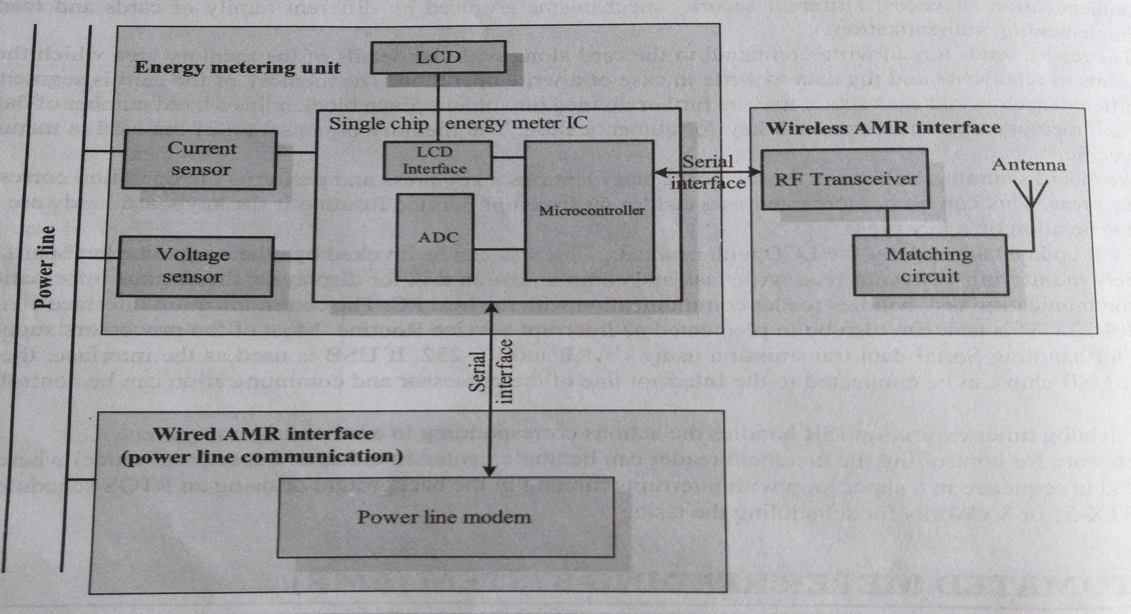
Automated meter reading system

Slide 48
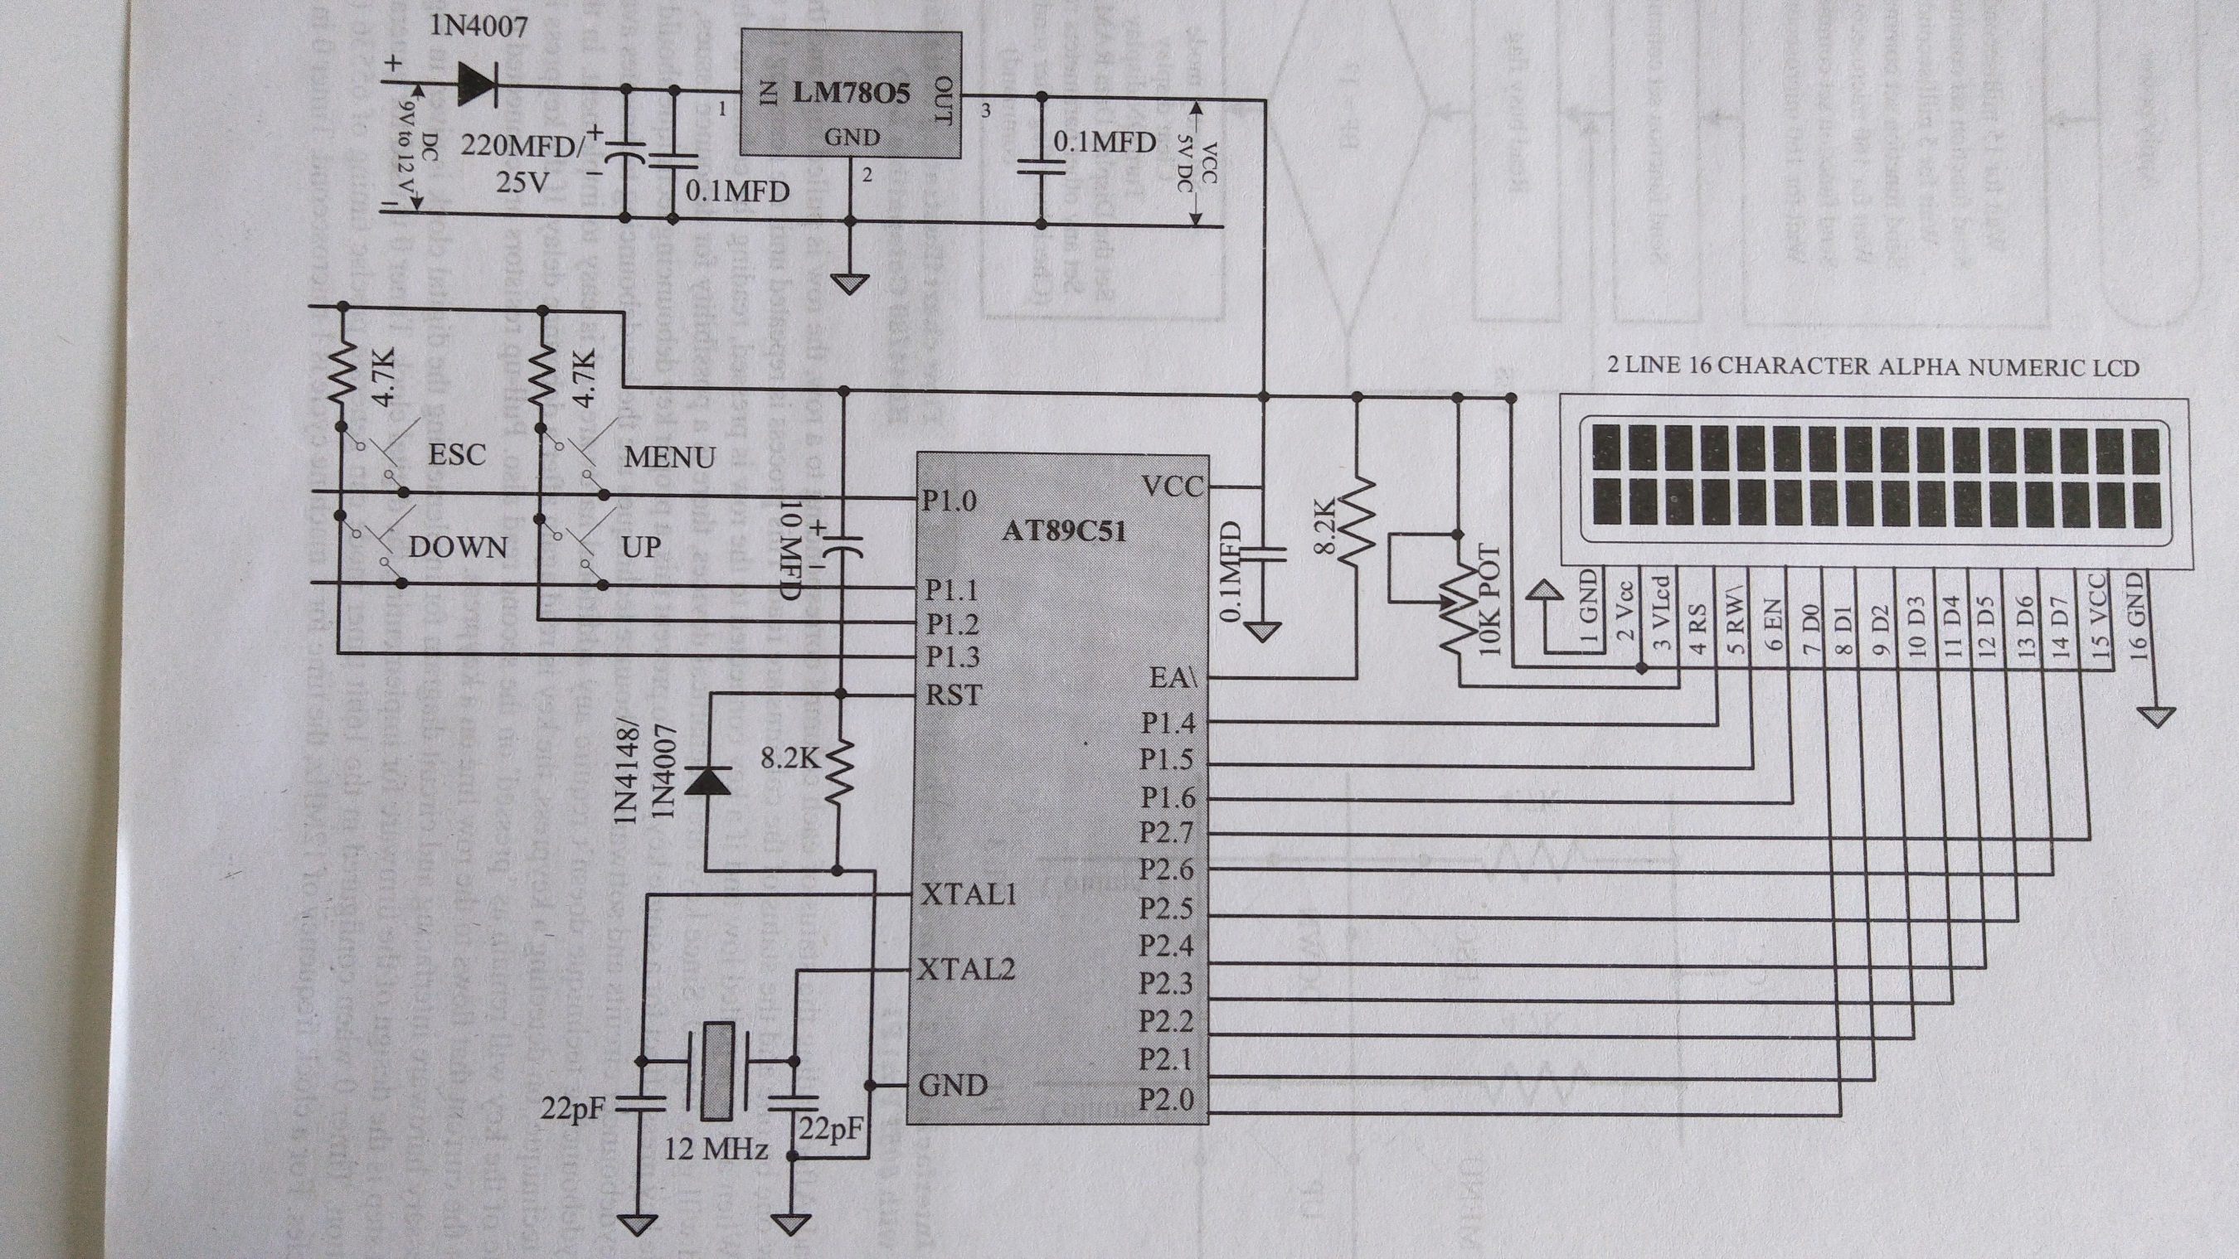
Digital Clock

Slide 49
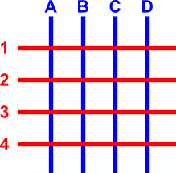
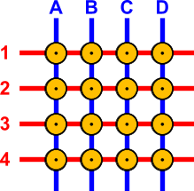
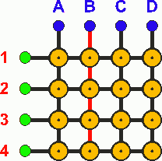
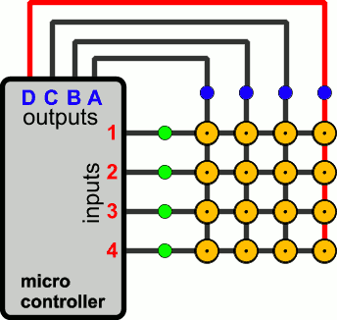
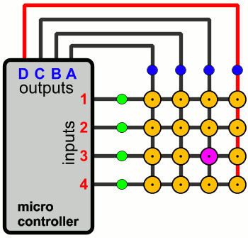
Keyboard Interfacing

Slide 50
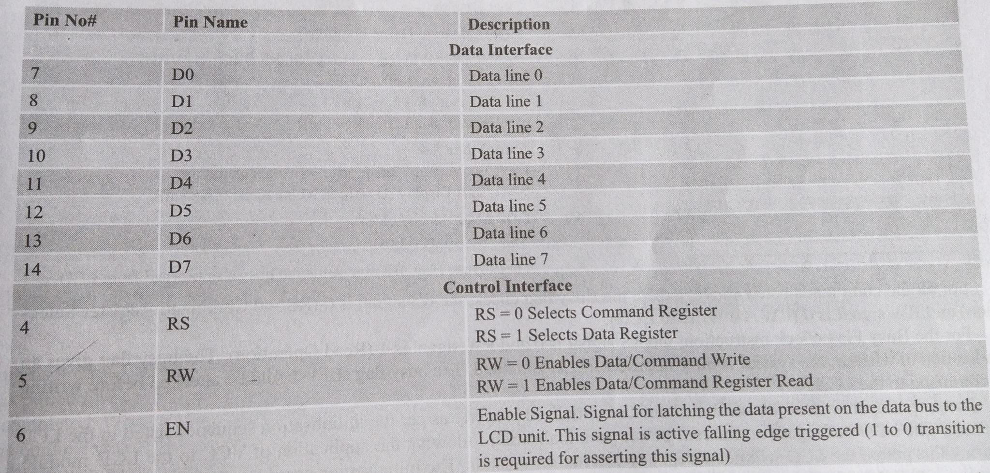
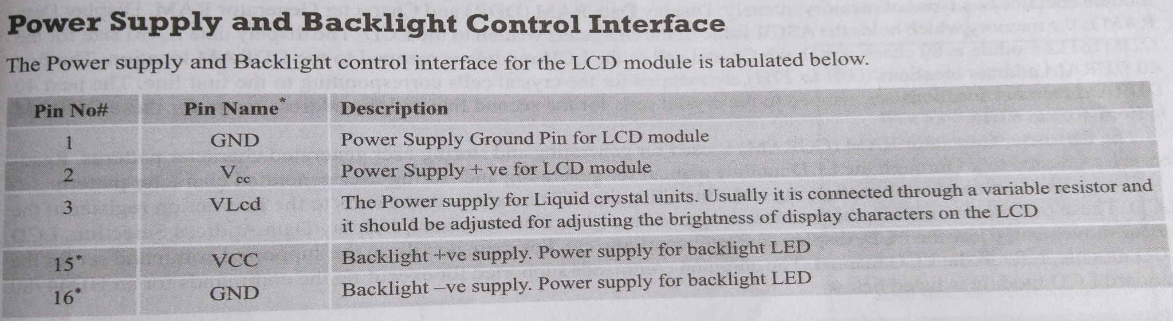
Power supply and
Backlight control interface
Control and Data Interface

Slide 51
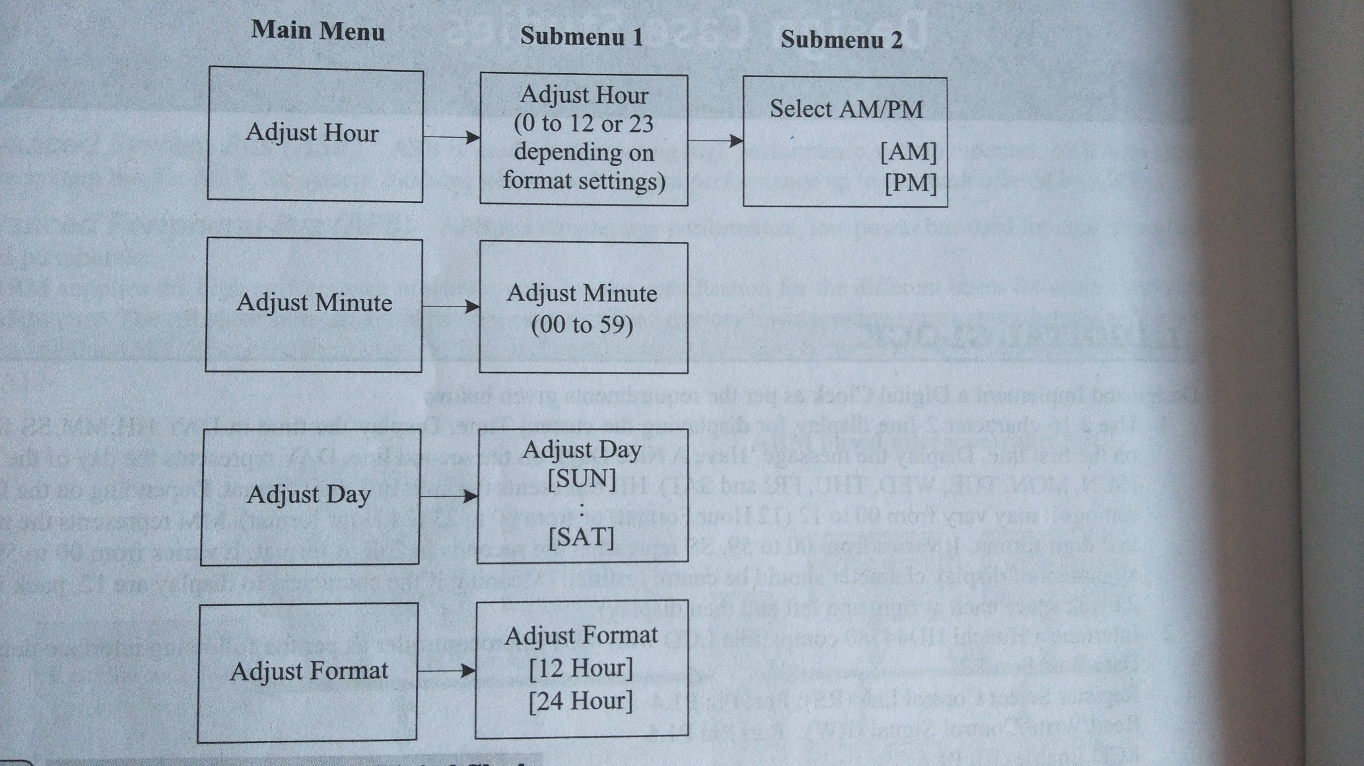
Menu implementation for Digital Clock

Slide 52
Smart Card Reader
It is a credit card sized plastic card containing memory or a “CPU and Memory”.
It follows a specific command sequence for data read/write operations is controlled by Smartcard Reader/Writer IC.
Based on the interface – two types – contact type and contact less type
Contact type – physical contacts between the reader and the smartcard for communication…
Contact less type - …

Slide 53
Battery operated Contactless type smartcard reader
Firmware requirements for building the handheld smartcard reader can be divided into the following task:
Startup task
Battery monitoring and charge controlling task
Card read/write operation task
Communication task
Keyboard scanning task
LCD update task
Watchdog timer expire event

Slide 54
Smartcard read/write operation follows the sequence:
Initiate the request command for checking the presence of card in the vicinity of the reader – if yes – responds to the reader with Answer to Request (ATR)
Upon receiving the ATR, the reader sends a command to capture the serial no of the card
Reader selects the serial no of a card from the list of SR Nos received and sends a command to select the specified card.
The card whose sr no matches with the one sent by the reader responds to the reader and all other cards enters sleep state.
It establishes the communication channel exclusively between the reader and a card.
The reader authenticates the card with an encrypted key.
The reader sends a read/write command to the card along with the details of the memory area.

Slide 55
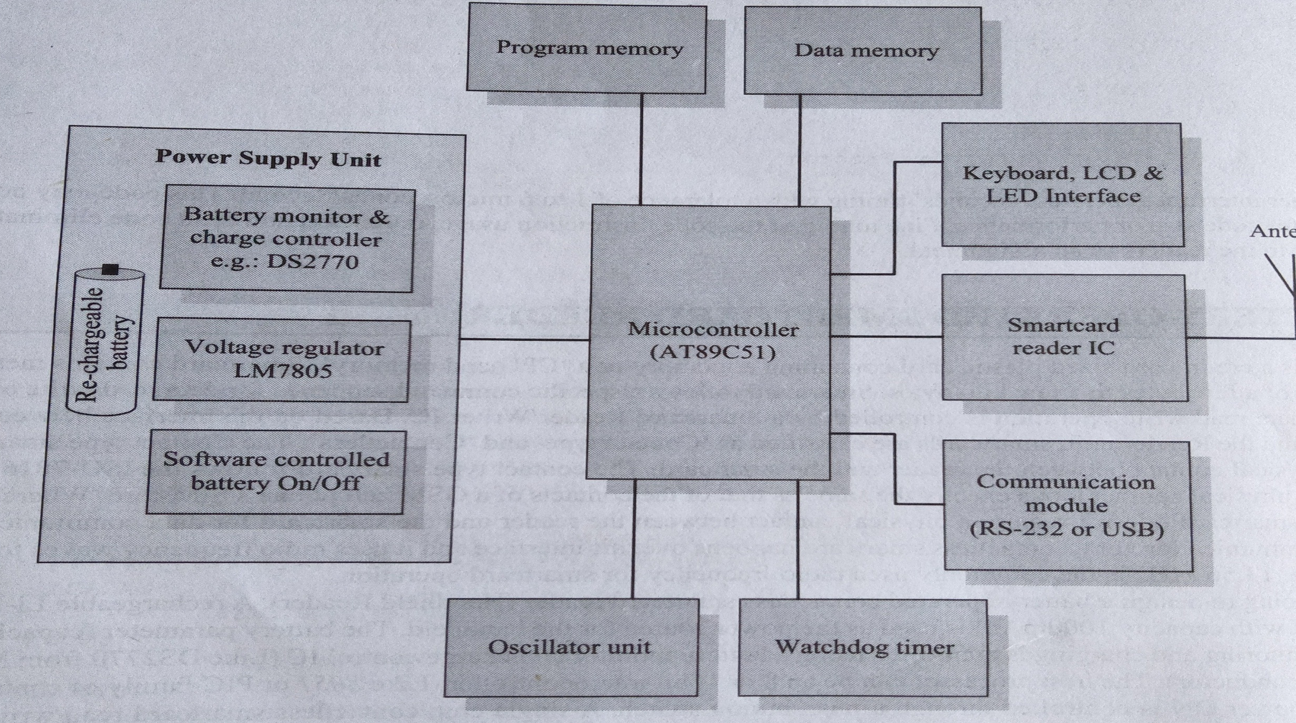
Smart Card Reader

Slide 56
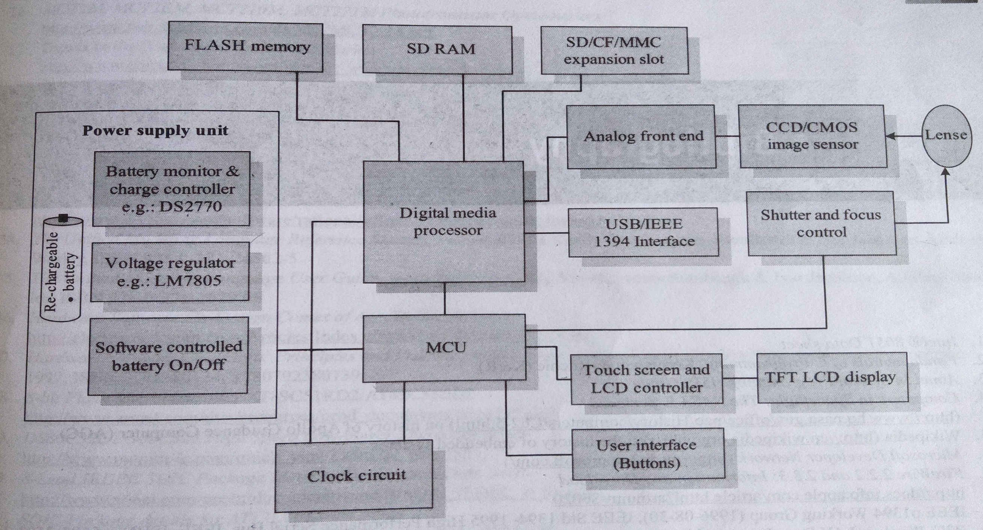
Digital Camera

Slide 57
Operating systems

Slide 58
What’s an Operating System?
Provides environment for executing programs
Process abstraction for multitasking/concurrency
Scheduling
Hardware abstraction layer (device drivers)
File systems
Communication
We will focus on concurrent, real-time issues

Slide 59
Operating systems
Off-the-shelf operating systems
Embedded operating systems
Real time operating systems
Handheld operating systems

Slide 60
Off-the-shelf operating systems
To reduce the development time and effort, it is preferable to use an off-the-shelf OS. Following are the categories
Non-real-time embedded operating systems
Real-time operating systems
Handheld/mobile OS –
Palm OS,
Symbian OS
Windows CE

Slide 61
Commonalties of the OS
Integrated Development environment (IDE) – to facilitate easy and fast development, vendors supply an IDE that includes editor, complier, debugger and also the necessary cross-platform dev. Tools.
POSIX compatibility: POSIX1003.1-2001 standard specifies the Application Programming Interface to achieve portability of applications.
TCP/IP support:
TCP/IP protocol stack, including application layer protocols such as FTP, SMTP, HTTP, is integrated along with the OS software.
Function calls will be provided to access the network-related services.
Device Drivers: No. of device drivers are provided for commonly used devices such as serial ports, parallel port, USB etc.
A Device Driver kit (DDK) is also generally included that facilitates fast dev of device driver.

Slide 62
POSIX
The Portable Operating System Interface (POSIX)^{[1]} is a family of standards specified by the IEEE Computer Society for maintaining compatibility between operating systems.
POSIX defines the application programming interface (API), along with command line shells and utility interfaces, for software compatibility with variants of Unix and other operating systems.
This interface is a set of function calls to access the operating system objects and services.

Slide 63
Embedded OS
Embedded OS use a preemptive priority based kernel, but they do not meet strict deadlines. The stripped-down versions of the desktop OS can be used as embedded OS.
i.e. in the OS software, remove all the unnecessary features and make the kernel occupy a small memory and you have the embedded OS.
This is used in the following three OS:
Embedded NT
Windows XP embedded
Embedded Linux

Slide 64
RTOS: Role of an OS in Real Time Systems
Standalone Applications
Often no OS involved
Micro controller based Embedded Systems
Some Real Time Applications are huge & complex
Multiple threads
Complicated Synchronization Requirements
File system / Network / Windowing support
OS primitives reduce the software design time

Slide 65
Background: What’s a “Real Time” System?
When correctness of results depend on content and time
Hard or Soft: indicates how forgiving the system is

Slide 66
What makes an OS Real-Time?
Predictable (possibly deterministic behavior), that’s all
Not necessarily fast

Slide 67
How do they work?
Tasks are scheduled by OS according to fixed priority (typically)
Tasks can’t directly interact; they use messages or shared memory & semaphores to communicate

Slide 68
Designing an RTOS: Typical Features
Many POSIX Specs Exist
No virtual memory (swap file)
Shared memory capabilities
High-resolution timer(s)
Real-time signals/QoS

Slide 69
Designing an RTOS: End Goal
Have known switching & scheduling overhead
Avoid common problems like priority inversion and deadlock

Slide 70
Designing an RTOS: Common Problems
Priority inversion
High-level task stalled due to low-level using shared resources, then a medium-level task holding up the low-level one
Solution: Priority inheritance – give low-level task high-level priority
Mars Pathfinder had this problem

Slide 71
Designing an RTOS: Common Problems (con’t)
Deadlock
Two semaphores locked out of order by two tasks and circularly block each other
Solution: “Instant Inheritance” implementation of Priority Ceiling Protocol – semaphores possibly needed by higher processes become priority tokens

Slide 72
Designing with an RTOS: What do you need?
Task information
Priorities for each task
Worst-case runtime
Best-case period
Interference information
Deadline Monotonic Analysis (DMA) calculations

Slide 73
Features of Real Time OS (RTOS)
Scheduling.
Resource Allocation.
Interrupt Handling.
Other issues like kernel size.

Slide 74
Real-time OS
Few RTOS:
QNx Neutrino
VxWorks
MicroC/OS-II
RTLinux

Slide 78
Priority Scheduling
Each job is assigned a priority.
FCFS within each priority level.
Select highest priority job over lower ones.
Rational: higher priority jobs are more mission-critical
Example: DVD movie player vs. send email
Problems:
May not give the best AWT
Starvation of lower priority processes

Slide 79
Priority Scheduling: Example
Process | Duration | Priority | Arrival Time
P1 | 6 | 4 | 0
P2 | 8 | 1 | 0
P3 | 7 | 3 | 0
P4 | 3 | 2 | 0
Do it yourself
P2 (8)
P4 (3)
P3 (7)
P1 (6)
0
8
11
18
24
P2 waiting time: 0
P4 waiting time: 8
P3 waiting time: 11
P1 waiting time: 18
The average waiting time (AWT): (0+8+11+18)/4 = 9.25
(worse than SJF)

Slide 80
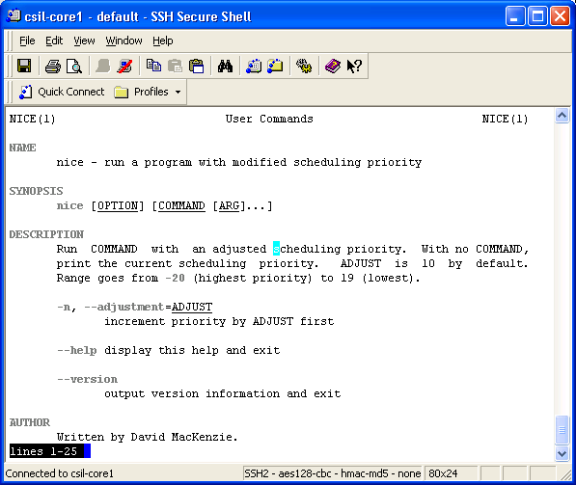
Set Priority
Every process has a default priority
User can also change a process priority
The nice command

Slide 81
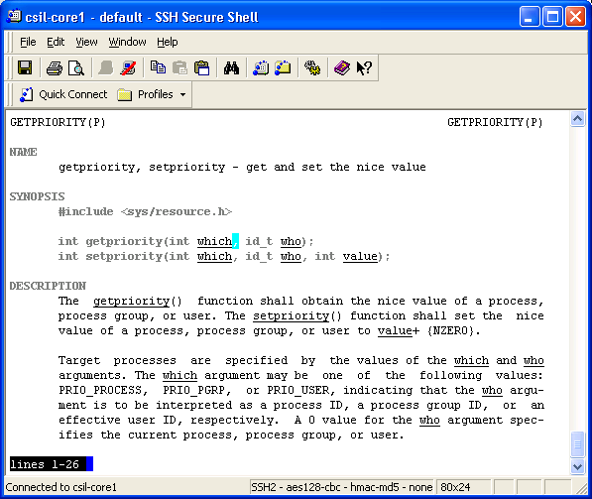
Set/Get Process Priority
int getpriority(int which, id_t who);
int setpriority(int which, id_t who, int value);

Slide 83
Real-time Scheduling Taxonomy
Job (J_{ij}): Unit of work, scheduled and executed by system. Jobs repeated at regular or semi-regular intervals modeled as periodic
Task (T_{i}): Set of related jobs.
Jobs scheduled and allocated resources based on a set of scheduling algorithms and access control protocols.
Scheduler: Module implementing scheduling algorithms
Schedule: assignment of all jobs to available processors, produced by scheduler.
Valid schedule: All jobs meet their deadline
Clock-driven scheduling vs Event(priority)-driven scheduling
Fixed Priority vs Dynamic Priority assignment

Slide 84
Scheduling Periodic Tasks
In hard real-time systems, set of tasks are known apriori
Task T_{i} is a series of periodic Jobs J_{ij}. Each task has the following parameters
t_{i} - period, minimum interrelease interval between jobs in Task T_{i}.
c_{i} - maximum execution time for jobs in task T_{i}.
r_{ij} - release time of the j^{th} Job in Task i (J_{ij} in T_{i}).
ϕ_{i} - phase of Task T_{i}, equal to r_{i1}.
u_{i} - utilization of Task T_{i} = c_{i} / t_{i}
In addition the following parameters apply to a set of tasks
H - Hyperperiod = Least Common Multiple of p_{i} for all i: H = lcm(p_{i}), for all i.
U - Total utilization = Sum over all u_{i}.
Schedulable utilization of an algorithm U_{s}
If U < U_{s} the set of tasks can be guaranteed to be scheduled

Slide 85
Real-Time Scheduling Algorithms
Fixed Priority Algorithms
Dynamic Priority Algorithms
Hybrid algorithms
Rate Monotonic scheduling
Deadline Monotonic scheduling
Earliest Deadline First
Least Laxity First
Maximum Urgency First

Slide 86
Scheduling Algorithm Static vs. Dynamic
Static Scheduling:
All scheduling decisions at compile time.
Temporal task structure fixed.
Precedence and mutual exclusion satisfied by the schedule (implicit synchronization).
One solution is sufficient.
Any solution is a sufficient schedulability test.
Benefits
Simplicity

Slide 87
Scheduling Algorithm Static vs. Dynamic
Dynamic Scheduling:
All scheduling decisions at run time.
Based upon set of ready tasks.
Mutual exclusion and synchronization enforced by explicit synchronization constructs.
Benefits
Flexibility.
Only actually used resources are claimed.
Disadvantages
Guarantees difficult to support
Computational resources required for scheduling

Slide 88
Scheduling Algorithm Preemptive vs. Nonpreemptive
Preemptive Scheduling:
Event driven.
Each event causes interruption of running tasks.
Choice of running tasks reconsidered after each interruption.
Benefits:
Can minimize response time to events.
Disadvantages:
Requires considerable computational resources for scheduling

Slide 89
Choosing the Time Quantum
Time slice too large
FIFO behavior
Poor response time
Time slice too small
Too many context switches (overheads)
Inefficient CPU utilization
Heuristic:
70-80% of jobs block within time-slice
Typical time-slice
10-100 ms (depends on job priority)

